Slide 1
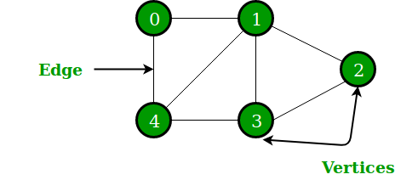
Graphs
Santosh Kumar Verma
Mentor@GeeksforGeeks

Slide 2
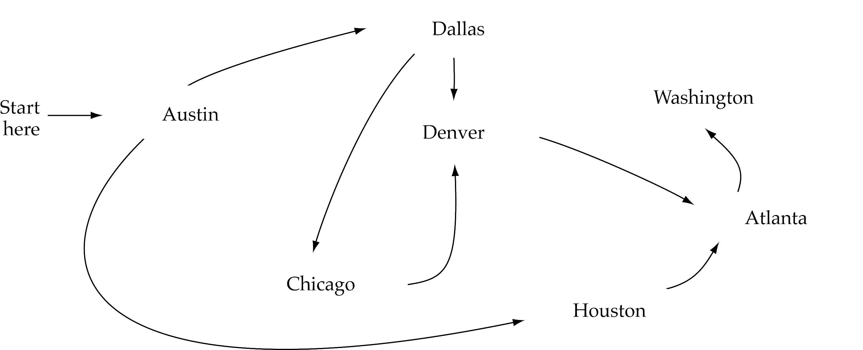
What is a graph?
A data structure that consists of a set of nodes (vertices) and a set of edges that relate the nodes to each other
The set of edges describes relationships among the vertices
A graph G is defined as follows:
G=(V,E)
V(G): a finite, nonempty set of vertices
E(G): a set of edges (pairs of vertices)

Slide 3
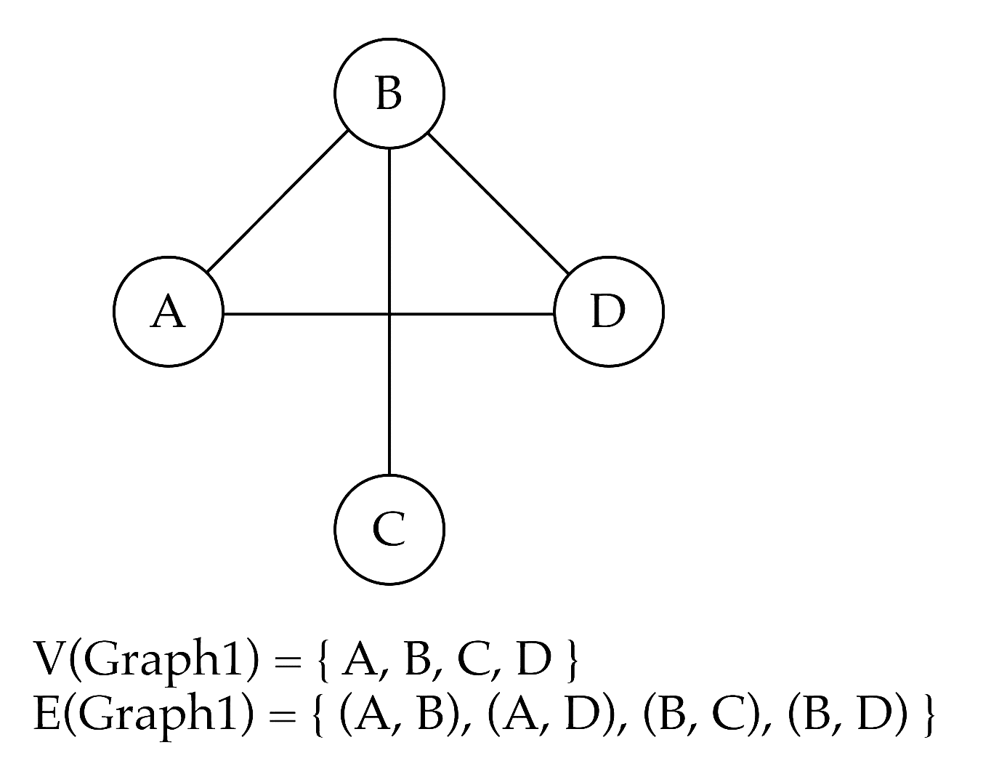
Directed vs. undirected graphs
When the edges in a graph have no direction, the graph is called undirected

Slide 4

Directed vs. undirected graphs (cont.)
When the edges in a graph have a direction, the graph is called directed (or digraph)
Warning: if the graph is directed, the order of the vertices in each edge is important !!
E(Graph2) = {(1,3) (3,1) (5,9) (9,11) (5,7) (9,9), (11,1)

Slide 5
Trees vs graphs
Trees are special cases of graphs!!

Slide 6
Graph terminology
Adjacent nodes: two nodes are adjacent if they are connected by an edge
Path: a sequence of vertices that connect two nodes in a graph
Complete graph: a graph in which every vertex is directly connected to every other vertex
5 is adjacent to 7
7 is adjacent from 5

Slide 7
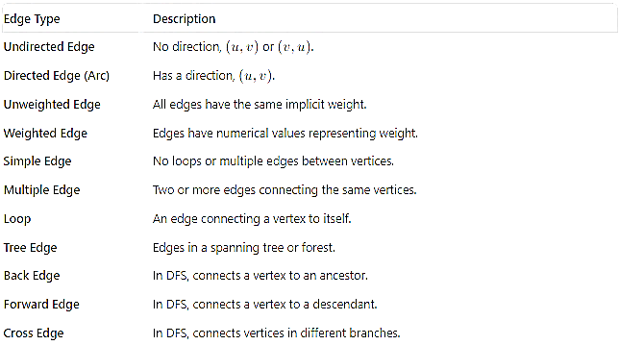
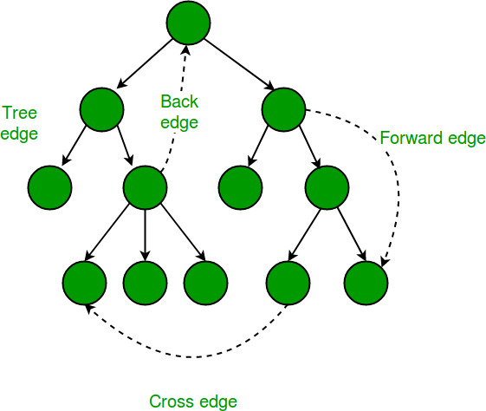

Slide 8
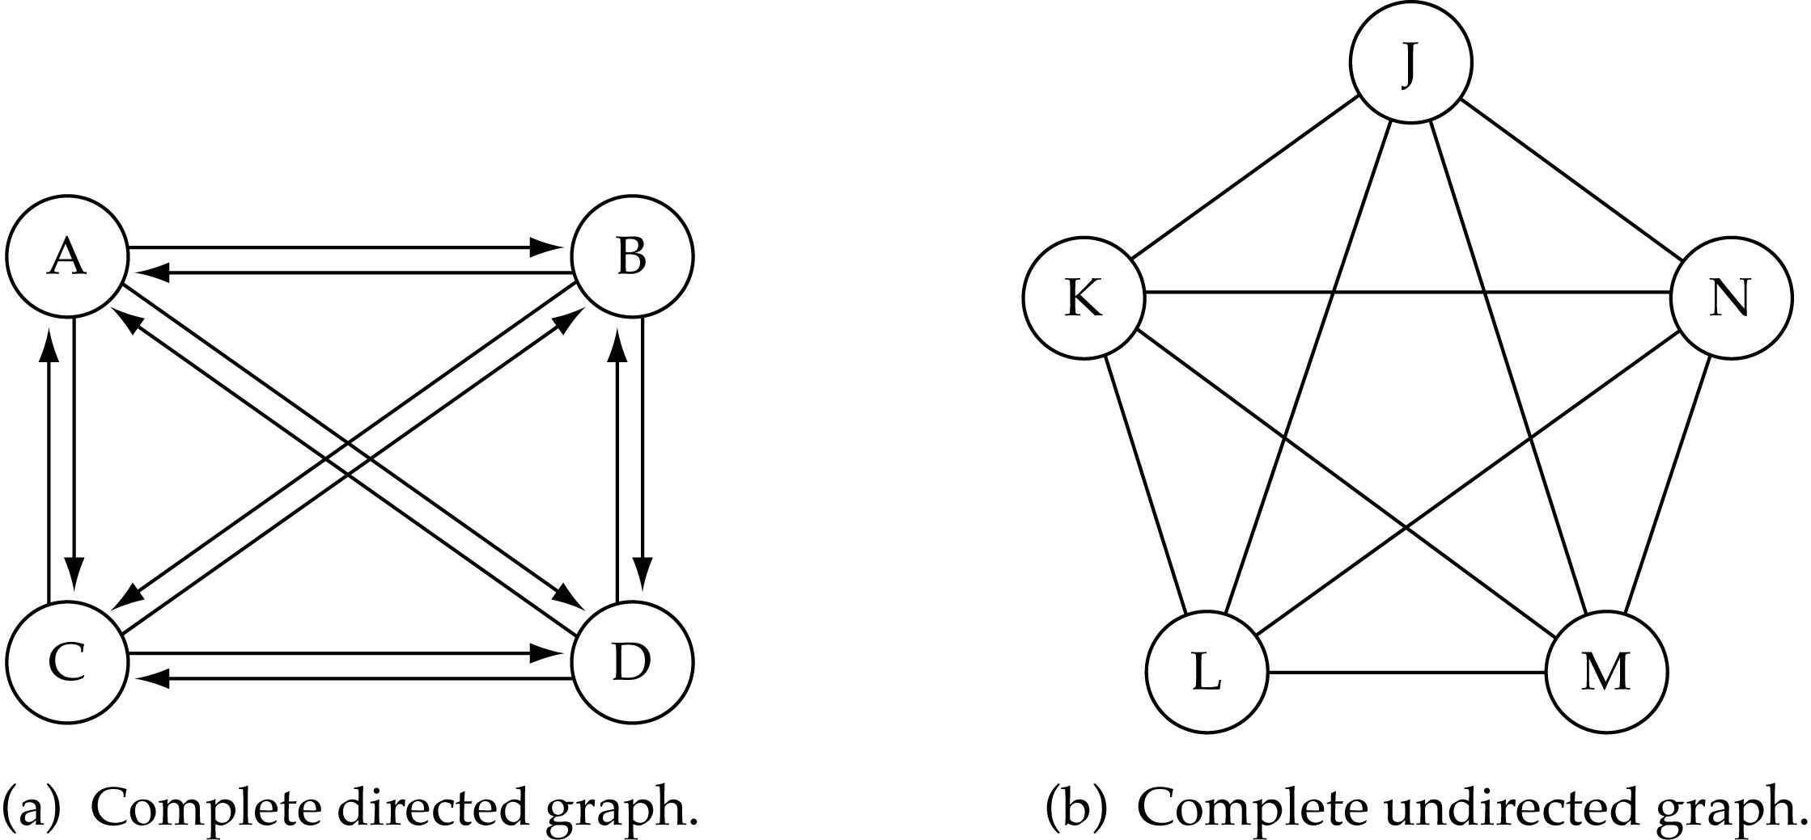
Graph terminology (cont.)
What is the number of edges in a complete directed graph with N vertices?
N * (N-1)

Slide 9
Graph terminology (cont.)
What is the number of edges in a complete undirected graph with N vertices?
N * (N-1) / 2

Slide 10
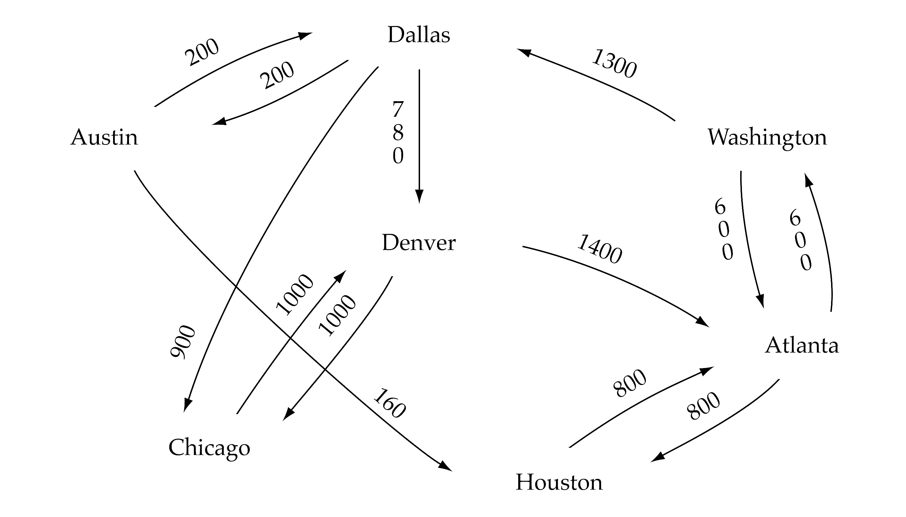
Graph terminology (cont.)
Weighted graph: a graph in which each edge carries a value

Slide 11

Graph implementation
Array-based implementation
A 1D array is used to represent the vertices
A 2D array (adjacency matrix) is used to represent the edges

Slide 12
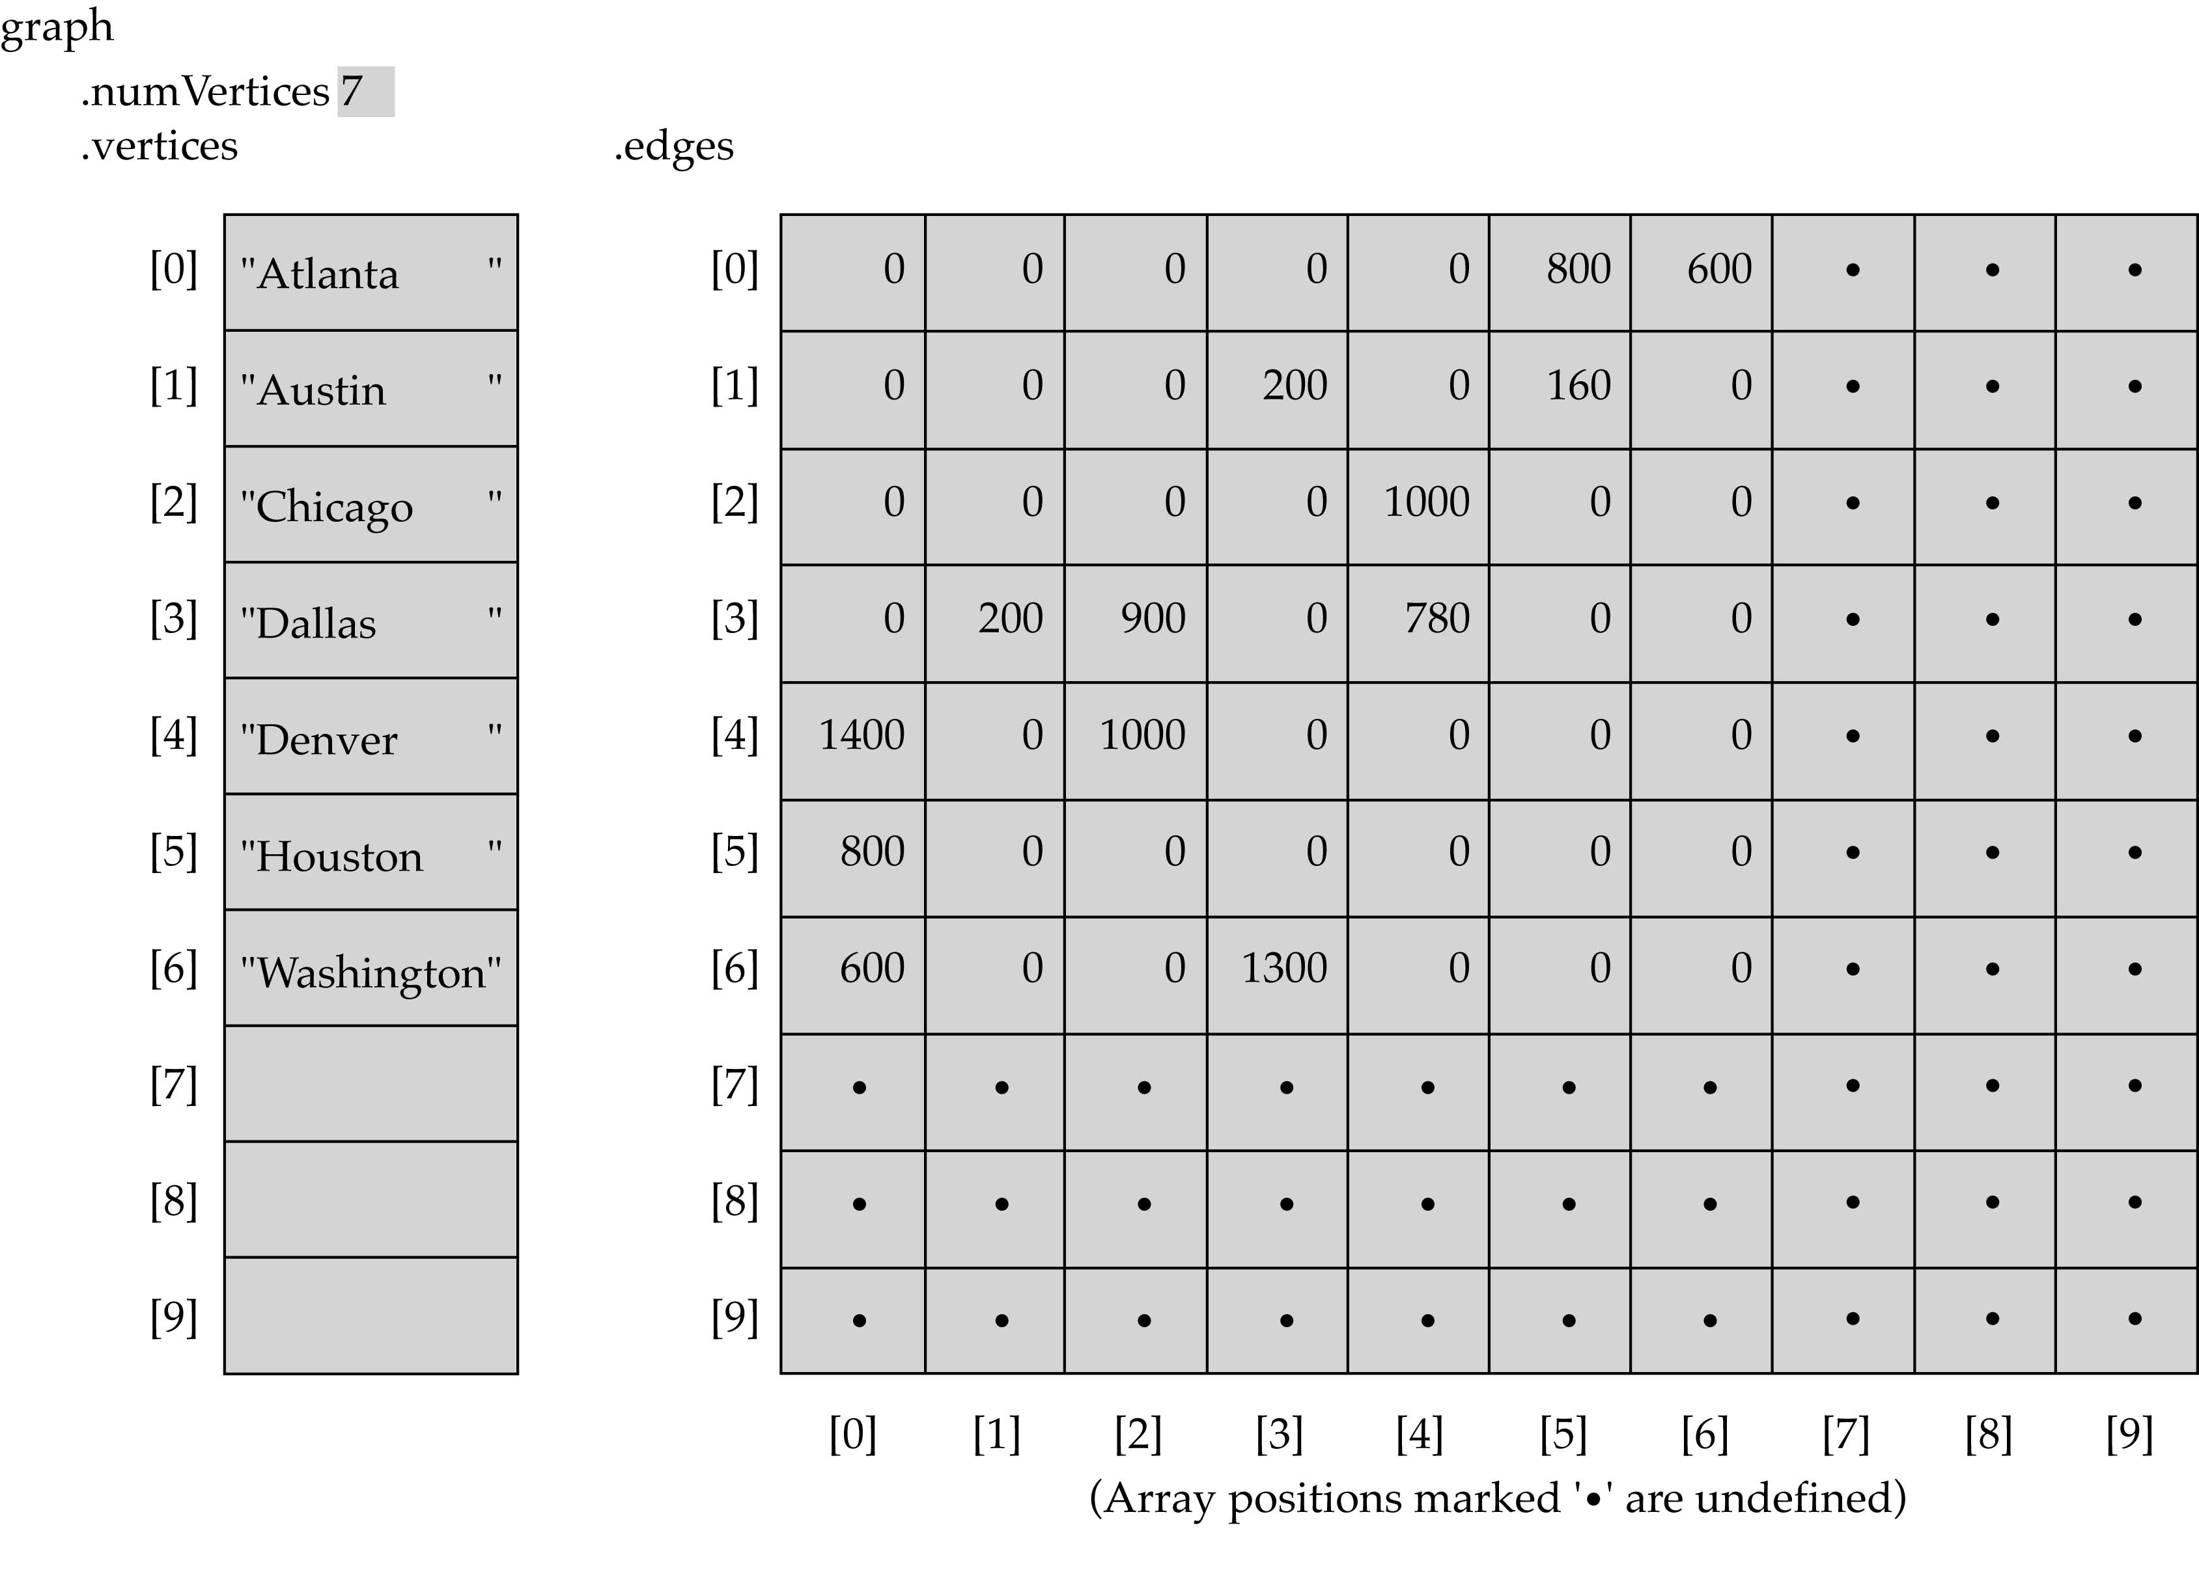
Array-based implementation

Slide 13

Graph implementation (cont.)
Linked-list implementation
A 1D array is used to represent the vertices
A list is used for each vertex v which contains the vertices which are adjacent from v (adjacency list)

Slide 14
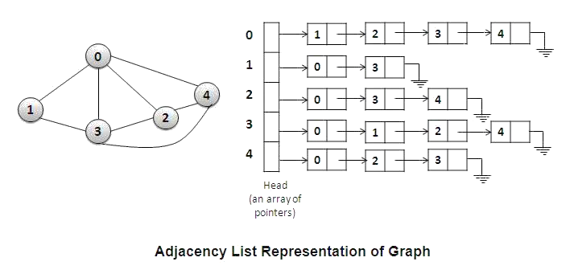
Linked-list implementation

Slide 15
Adjacency matrix vs. adjacency list representation
Adjacency matrix
Good for dense graphs --|E|~O(|V|²)
Memory requirements: O(|V| + |E| ) = O(|V|² )
Connectivity between two vertices can be tested quickly
Adjacency list
Good for sparse graphs -- |E|~O(|V|)
Memory requirements: O(|V| + |E|)=O(|V|)
Vertices adjacent to another vertex can be found quickly

Slide 16
Graph searching
Problem: find a path between two nodes of the graph (e.g., Pune and Noida)
Methods: Depth-First-Search (DFS) or Breadth-First-Search (BFS)
During the execution of the nodes of a graph, a node can have one of three states:
Status 1 (White color): The initial state of any node (Ready state)
Status 2 (Gray color): The node is in the queue or stack i.e. waiting status of the node. (Waiting State)
Status 3 (Black color): The node has been processed, removed from stack/queue. (Processed state)

Slide 17
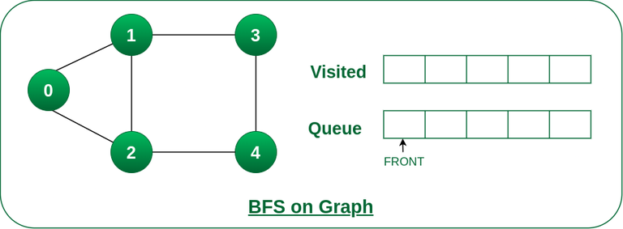
BFS
procedure BFS(G,s)
for each vertex v ∈ V[G] do
explored[v] ← false
d[v] ← ∞
end for
explored[s] ← true
d[s] ← 0
Q:= a queue data structure, initialized with s
while Q != φ do
u ← remove vertex from the front of Q
for each v adjacent to u do
if not explored[v] then
explored[v] ← true
d[v] ← d[u] + 1
insert v to the end of Q
end if
end for
end while
end procedure
*

Slide 18
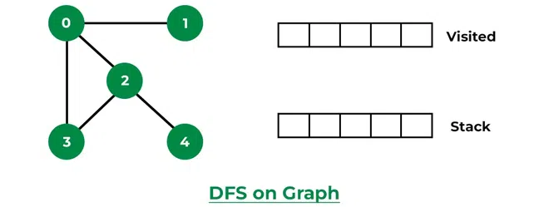
DFS
DFS(G,v) ( v is the vertex where the search starts )
Stack S := {}; ( start with an empty stack )
for each vertex u, set visited[u] := false;
push S, v;
while (S is not empty) do
u := pop S;
if (not visited[u]) then
visited[u] := true;
for each unvisited neighbor w of u
push S, w;
end if
end while
END DFS()

Slide 19
DFS Algorithm:
Initialize all nodes to the ready state. i.e. color of all nodes to be white.
Push the starting node A into STACK and change its status to the waiting state i.e. Color Gray and update its forward time stamp to be 1.
Repeat step 4 and step 5 until STACK is empty.
POP the top Node N of STACK. Process N and change its status to the processed state i.e. Black color.
PUSH all the adjacent nodes of N onto the stack if they are in the ready state (white). Change their status to the waiting state (gray). If no new visit i.e. (no node having white color) Backtrack is required go to step 4.
End.
BFS Algorithm:
Initialize all nodes to the ready state (White color).
Put the starting node in the Queue and change its status to the waiting state (Color Gray) and weight 0.
Repeat step 4 & step 5 until the Queue is empty.
Remove the front Node N of the queue. Process the removed node N and change its status to the processed state (Black color).
Add all the adjacent nodes of N that are in the ready state. Change their status to waiting for state and update their weight by (weight of N+1).
End.

Slide 20
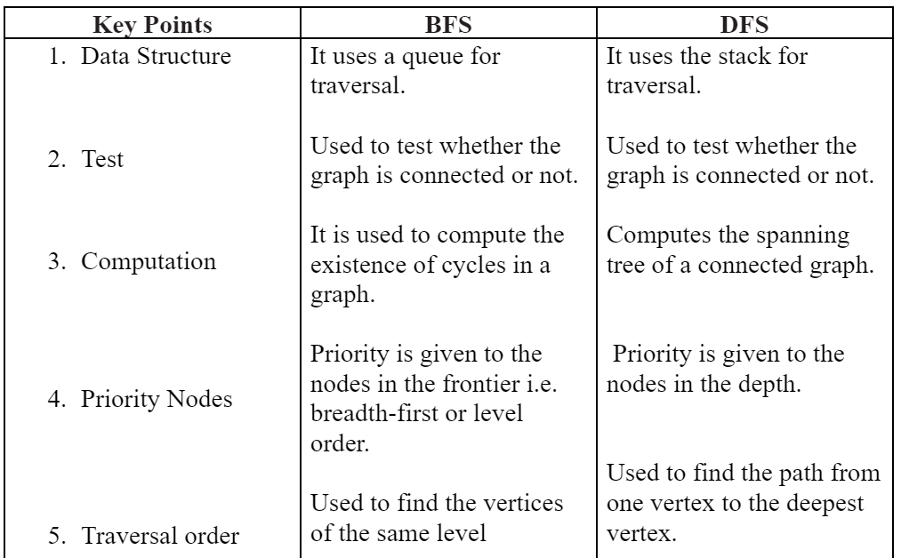
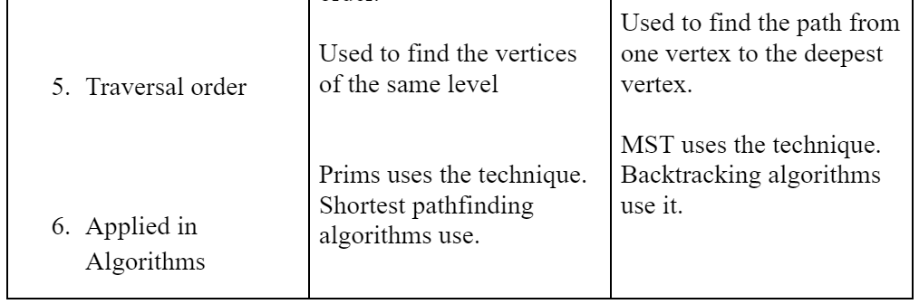
start
end

Slide 21
Shortest Path in Graphs
Single Source Shortest Path
All Pair Shortest Path
Dijkstra Algorithms (Positive weight only)
Bellman Ford Algorithm
(Negative weight permitted)
Floyd Warshal Algorithm

Slide 22
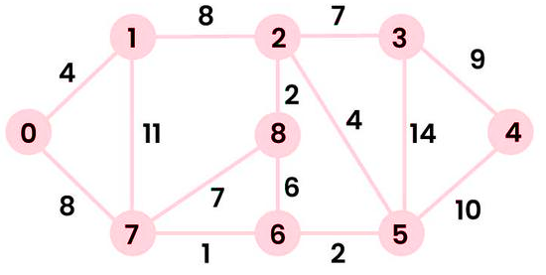
Dijkstra’s Algorithm
function Dijkstra(Graph, source):
for each vertex v in Graph.Vertices:
dist[v] ← INFINITY
prev[v] ← UNDEFINED
add v to Q
dist[source] ← 0
while Q is not empty:
u ← vertex in Q with minimum dist[u]
remove u from Q
for each neighbor v of u still in Q:
alt ← dist[u] + Graph.Edges(u, v)
if alt < dist[v]:
dist[v] ← alt
prev[v] ← u
return dist[], prev[]

Slide 23
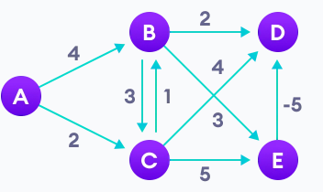
Bellman Ford Algorithm
function bellmanFord(G, S)
for each vertex V in G
distance[V] <- infinite
previous[V] <- NULL
distance[S] <- 0
for each vertex V in G
for each edge (U,V) in G
tempDistance <- distance[U] + edge_weight(U, V)
if tempDistance < distance[V]
distance[V] <- tempDistance
previous[V] <- U
for each edge (U,V) in G
If distance[U] + edge_weight(U, V) < distance[V}
Error: Negative Cycle Exists
return distance[], previous[]

Slide 24
Minimum Spanning Tree
A Minimum Spanning Tree (MST) is a subset of the edges of a connected, undirected graph that connects all the vertices together without any cycles and with the minimum possible total edge weight. Here are some key concepts and popular algorithms for finding the MST:
Spanning Tree: A subgraph that includes all the vertices of the original graph and is a tree (i.e., it is connected and acyclic).
Minimum Spanning Tree: A spanning tree with the smallest possible sum of edge weights.
MST
Kruskal’s Algorithm
Prim’s Algorithm

Slide 25
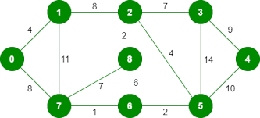
Kruskal’s Algorithm
algorithm Kruskal(G) is
F:= ∅
for each v in G.V do
MAKE-SET(v)
for each {u, v} in G.E ordered by weight({u, v}), increasing do
if FIND-SET(u) ≠ FIND-SET(v) then
F := F ∪ { {u, v} }
UNION(FIND-SET(u), FIND-SET(v))
return F

Slide 26
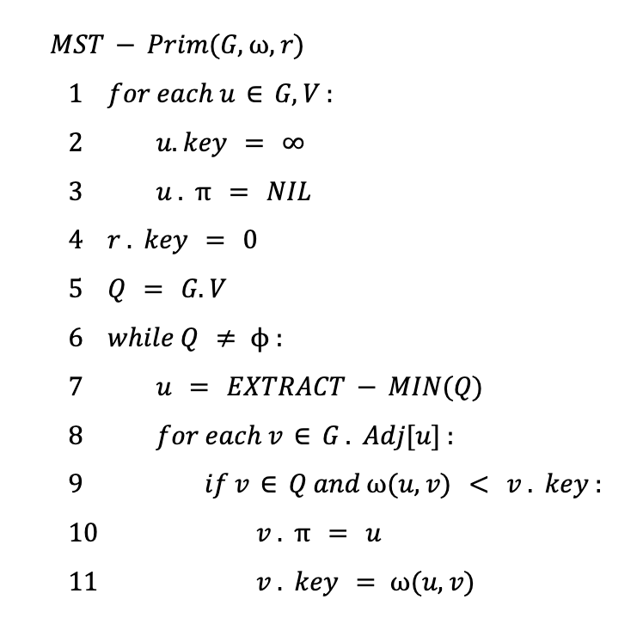
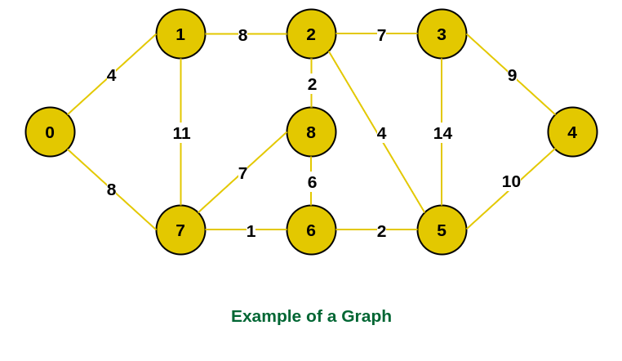
Prim’s Algorithm

Slide 27
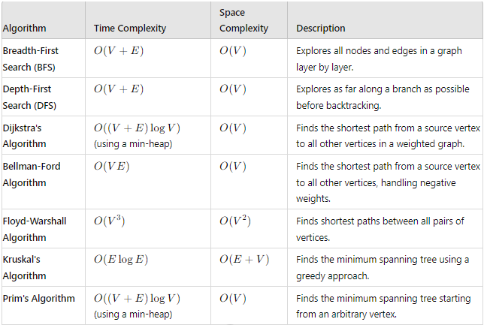

Slide 28
Graph Applications:
Social Networks:
Graphs model relationships between entities. Social networks like Facebook and LinkedIn use graphs to represent connections between users.
Networks and Routing Algorithms:
Graphs are used to model and analyze computer networks. Routing algorithms, such as Dijkstra's algorithm, operate on graphs to find the shortest path between nodes.
Dependency Resolution:
Graphs are used to represent dependencies between tasks in project management or software builds. Dependency graphs help determine the order of execution.
Web Page Linking:
The World Wide Web can be represented as a directed graph, where web pages are nodes, and hyperlinks are edges.
Circuit Design:
Graphs model the connectivity of electronic circuits, helping engineers design and analyze complex systems.
Recommendation Systems:
Collaborative filtering algorithms often use graphs to model the preferences and connections between users and items for personalized recommendations.
Geographical Maps:
Graphs can represent roads, cities, and transportation networks, aiding in route planning and logistics.
Game Development:
Graphs are used to represent game maps, character interactions, and decision trees in game development.

Slide 29
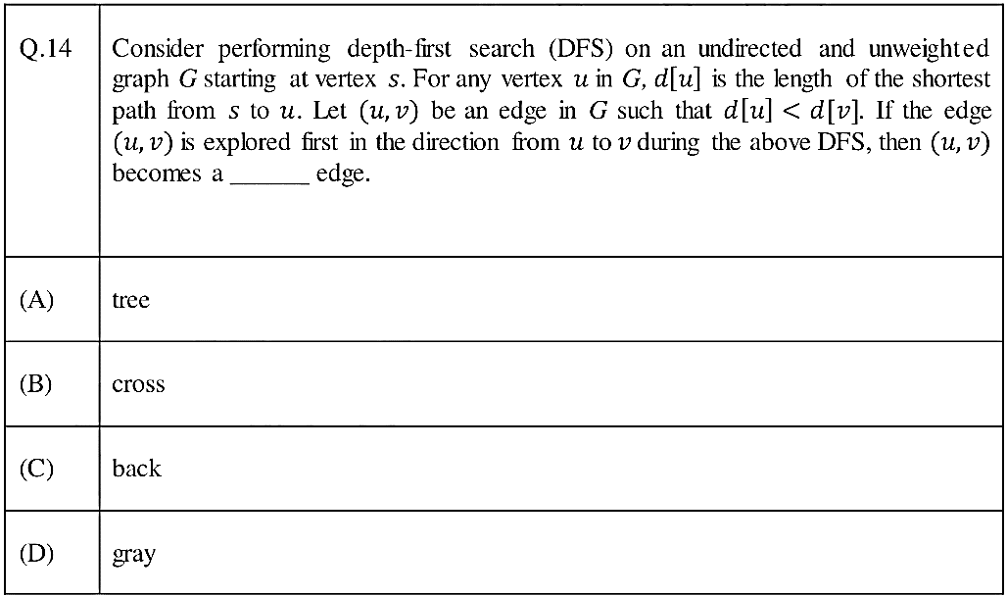
Gate DA -2024

Slide 30
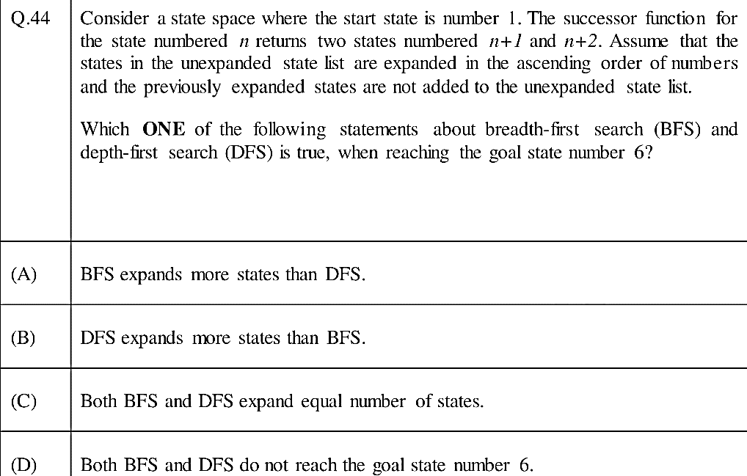
Gate DA -2024

Slide 31
Gate CS –2016 Set-1
Breadth First Search (𝐵𝐹𝑆) is started on a binary tree beginning from the root vertex. There is a vertex 𝑡 at a distance four from the root. If t is the 𝑛-th vertex in this 𝐵𝐹𝑆 traversal, then the maximum possible value of 𝑛 is ___________.

Slide 32
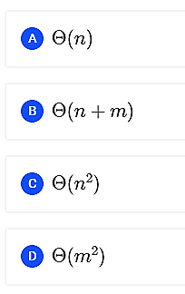
GATE CSE 2014 Set 1
Let G be a graph with n vertices and m edges. What is the tightest upper bound on the running time of Depth First Search on G, when G is represented as an adjacency matrix?

Slide 33
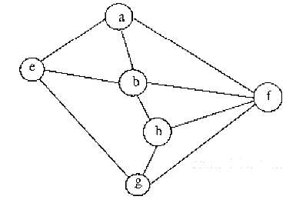
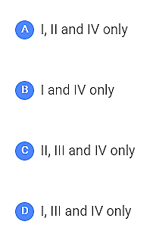
GATE CSE 2003
Consider the following graph among the following sequences I. a b e g h f II. a b f e h g III. a b f h g e IV. a f g h b e
What are depth first traversals of the above graph?

Slide 34
GATE CSE 2014 Set 2
Consider the tree arcs of a BFS traversal from a source node 𝑊 in an unweighted, connected, undirected graph. The tree 𝑇 formed by the tree arcs is a data structure for computing
the shortest path between every pair of vertices.
the shortest path from 𝑊 to every vertex in the graph.
the shortest paths from 𝑊 to only those nodes that are leaves of 𝑇.
the longest path in the graph.

Slide 35
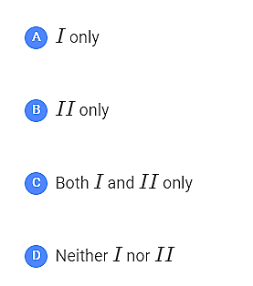
GATE CSE 2018
Let 𝐺 be a simple undirected graph. Let 𝑇_{𝐷} be a depth first search tree of 𝐺. Let 𝑇_{𝐵} be a breadth first search tree of 𝐺. Consider the following statements.
(𝐼) No edge of 𝐺 is a cross edge with respect to 𝑇_{𝐷}. (𝐴 cross edge in 𝐺 is between two nodes neither of which is an ancestor of the other in 𝑇_{𝐷}.) (𝐼𝐼) For every edge (𝑢,𝑣) of 𝐺, if 𝑢 is at depth 𝑖 and 𝑣 is at depth 𝑗 in 𝑇_{𝐵}, then |𝑖−𝑗|=1.
Which of the statements above must necessarily be true?

Slide 36
GATE CSE 2015 Set 3
Let 𝐺 be a connected undirected graph of 100 vertices and 300 edges. The weight of a minimum spanning tree of 𝐺 is 500. When the weight of each edge of 𝐺 is increased by five, the weight of a minimum spanning tree becomes ________.

Slide 37
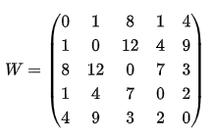
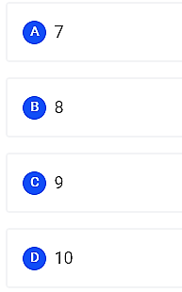
GATE CSE 2010
Consider a complete undirected graph with vertex set {0,1,2,3,4}. Entry W_{ij} in the matrix W below is the weight of the edge {i, j}
What is the minimum possible weight of a spanning tree T in this graph such that vertex 0 is a leaf node in the tree T?

Slide 38
Thank you!

